Slide 1

FINGER MOVEMENTS TO SPEECH CONVERSION
Presented By
P. Meghana – 22R21A12A7
P. Sri Vani – 22R21A12A8
R. Ramya – 22R21A12B8
N. Kumar Swamy – 22R21A12A5

Slide 2
Contents
Abstract
Introduction
Problem statement
Existing Solutions
Drawbacks
ProposedSystem
Architecture diagram
Conclusion
Future scope
References

Slide 3
Abstract
The hand gestures are one of the typical methods used in sign language.
This project presents a solution that will not only automatically recognize the hand gestures but will also convert it into speech so that impaired person can easily communicate with normal people.
The flex sensors attached to Arduino Nano will capture movements of hand. Based on the recognized gestures, the recorded soundtrack will be played.

Slide 4
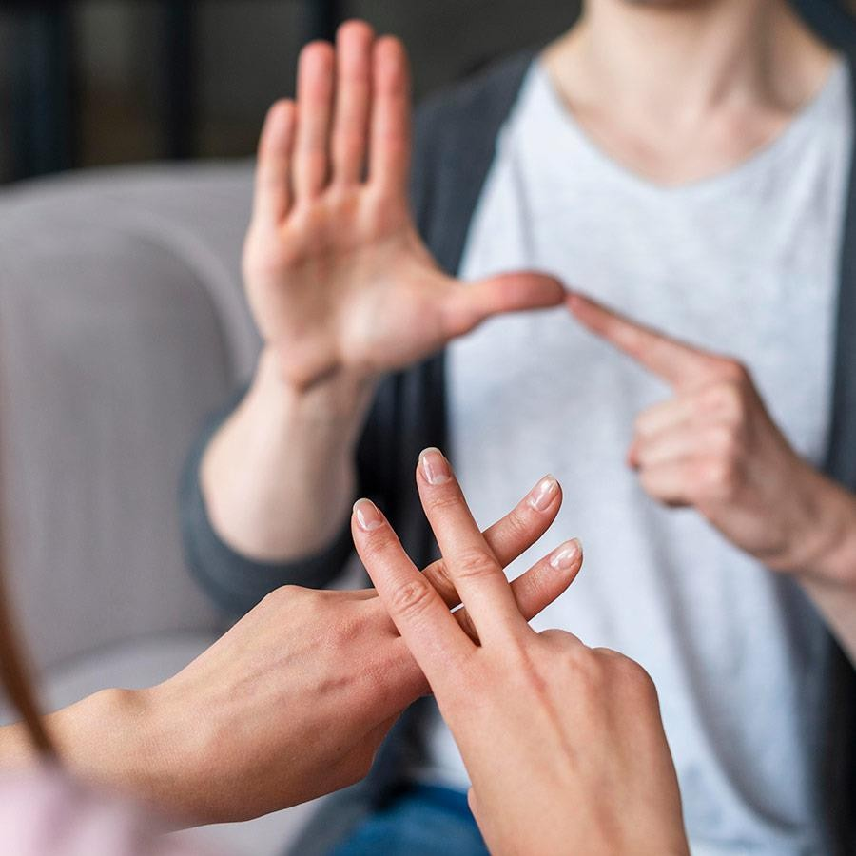
Introduction
Half-paralyzed people face serious problem in communication with normal people in their society.
To help them communicate with normal people for their basic needs we thought of creating something which will help them without the n_{on}eed of a third person as a translator.

Slide 5
Problem Statement
The objective of this project is to provide a tool to
aid the speech impaired ,half paralyzed retrieving the features of
the hand. This proposal has been developed using
Iot with properly designed and user-friendly
interface.

Slide 6
Drawbacks
Different cultures and languages may have varying interpretations of finger movements, which can lead to misunderstandings or misinterpretations when using this method in a diverse environment.
Finger movements may not offer the same degree of expressive freedom as traditional speech, leading to a limited vocabulary and reduced communication capabilities. Users may struggle to convey complex.

Slide 7
Existing Solutions
SPEECH NEURPROSTHE SIS
This is an important technological milestone for a person who cannot communicate naturally.
MYOPRO
It is a powered arm and hand orthosis (brace) designed to help restore function to the wearer's paralyzed or
weakened upper extremities
,helping
individuals perform actions and daily activities that might otherwise be impossible.

Slide 8
Proposed System
Our project consists of components Flex sensors, Arduino Nano,
Mini Speaker.
A flex sensor or bend sensor is a sensor that measures the amount of deflection or bending. Usually, the sensor is stuck to the surface, and resistance of sensor element is varied by bending the surface.

Slide 9
Architecture-Diagram
Finger Movements to Speech Conversion
|
+
+
|
|
v
|
|
v
|
|
v
|
|
+
+ +
| Processing
| (e.g., IMU)
+
| Acquisition |
| Module |
+ +
+ +
+------------------+
| and Feature |
| Extractionp |
| Module |
+ +
+---------------+
|
v

Slide 10
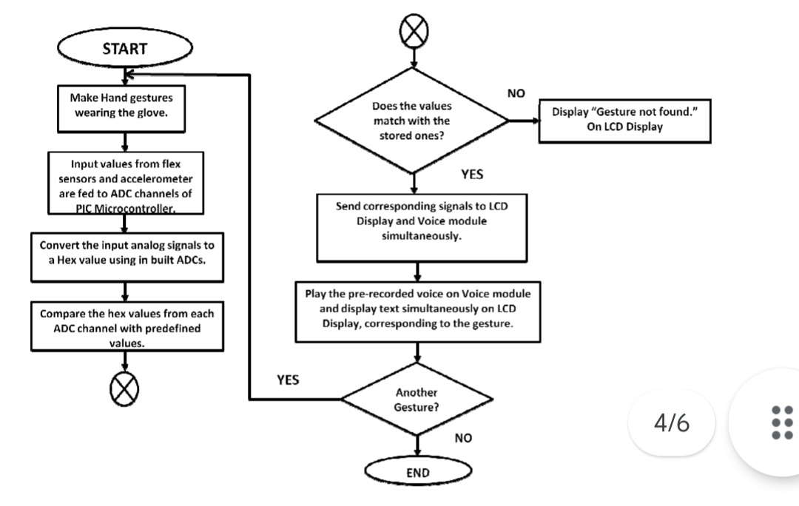
Architecture- Diagram

Slide 11
Conclusion
The project mainly emphasizes on the speech impaired people having the disability of miscommunication between them and the normal people. It mainly focuses on gesture recognition as that is the main means of communication for the speech impaired people. They communicate through gestures and these gestures are only understood by other speech impaired people and thus it cannot be understood by normal people and this is where the project comes into picture.

Slide 12
Future Scope
The application can be integrated with other mobile and IoT devices to improve user interaction and make the system more robust. The accuracy of the program can be further improvised by using neural networks.
An alternate stress could be put on the use of the application in the fields of medicines, military, governance etc. A genuine blend of various technologies in mentioned fields could make way for power tools and applications which will serve the community around the world.
Finally, the use can be further designed to make more accessible to the consumers. The whole point of making the solution as a commercially viable product for the users is to help the impaired community around the world.

Slide 13
References
1. M. Oudah, A. A. Naji, Javaan Chah, J. Imaging. 6, 8, (2020)
2. X. Ji, Z. Wang and X. Zhang, Design of Human Machine Interactive System based on Hand Gesture recognition, in the Proceedings of the 6th International Conference on Information Science and Control Engineering (ICISCE2019), (2019)
3. P. Sonwalker, T. Sakhare, A. Patil, S. Kale, Int. J. of Eng.
Tren. and Tech. 6, 9, (2019)
4. M. Alsheakhali, Hand gesture recognition system, in the Conference Proceedings of International Conference on Information and Communications Security (ICICS2011), 2011

Slide 14
Thank You!
We are happy to hear your feedback as well.

